Slide 1
Know-It CDAC- ACTS, Pune
A Presentation on “BuildMart”
By Group No:- 5

Slide 2
Group Members :
1. Rushikesh Nikam PRN:- 230943020061
2. Suyash Bhonde PRN:- 230943020098
3. Gajanan Shinde PRN:- 230943020030
4. Dhiraj Nagargoje PRN:- 230943020027

Slide 3
1.Project Introduction :
Buildmart :
Welcome to BuildMart, your ultimate destination for all your construction material needs!
At BuildMart, we've created a user-friendly e-commerce platform where customers can easily browse through a vast selection of construction materials, like Sand, Bricks, Paints, Concrete, Pipes, Cement etc…With just a few clicks, you can find everything you need to complete your project, all in one convenient place.
BuildMart isn't just for customers. We also welcome vendors to join our platform and showcase their products to a wide audience. Whether you're a large supplier or a local manufacturer. you can use this site.
With our commitment to quality, reliability, and customer satisfaction, BuildMart is the go-to destination for all your construction material needs.

Slide 4
1.1 Project Background :
At present, there exists a gap in the market where vendors lack a computerized system to effectively sell their construction materials. The conventional approach to purchasing construction equipment reveals several shortcomings when juxtaposed with the benefits of e-commerce. Some common faults inherent in the traditional system include:
Here are some common faults associated with the traditional system:
Limited Access
Limited Product Information
Lack of Price Transparency
Inconvenience for Comparison Shopping

Slide 5
1.2 Goals of the project :-
To develop and deploy a comprehensive e-commerce platform for construction materials that caters to the needs of Individual customers, construction material vendor, creating a thriving marketplace that facilitates seamless interactions and transactions within the construction industry.
1.3 Customers and Stakeholders:-
Customers : -
Construction material vendors who want to sell their materials.
Construction related work service providers who want to provide their services.
Individual customers want to buy the materials and services.

Slide 6
2.Stakeholders :
Individual Customers
Construction material vendors

Slide 7
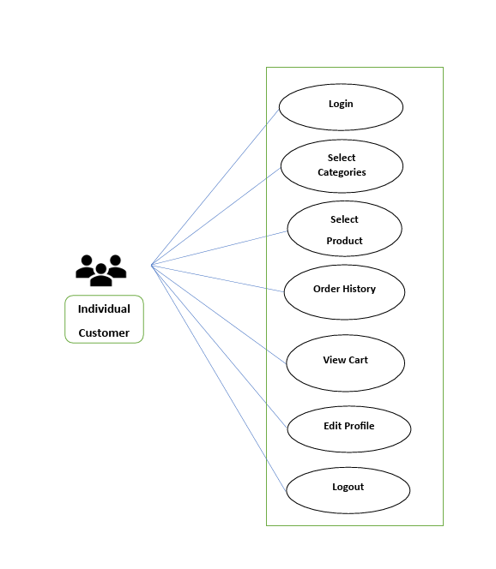
3.Individual Customers :

Slide 8
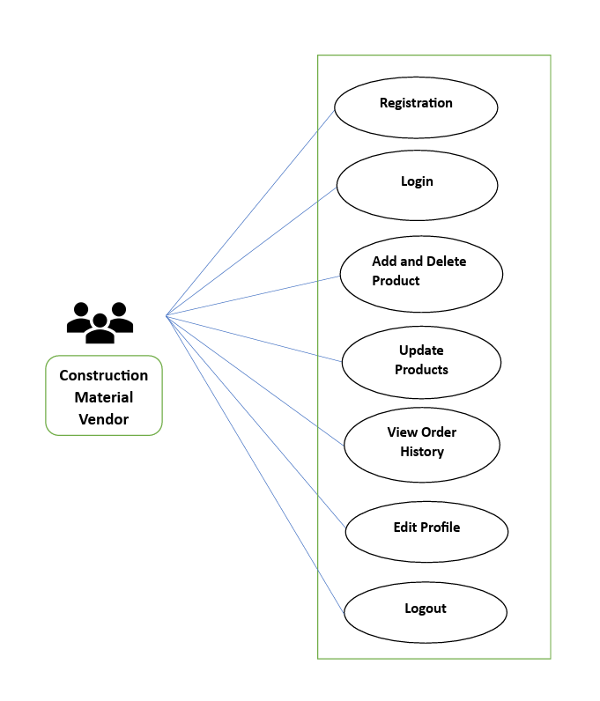
4.Construction Material Vendors :

Slide 9
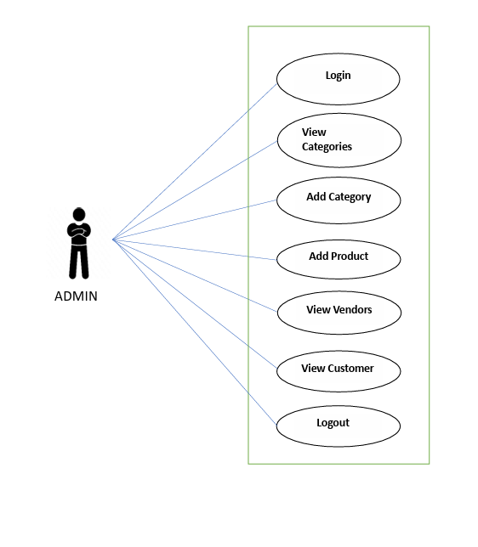
5.Admin :

Slide 10

6.Project Architecture :
Front End
Middle tier With
Microservices architecture
Running on
3306
Db Tier
Web Server running
on localhost:3000
Springboot Rest API
Server for Business
APIs
on localhost:8080
Using HTML, CSS
Bootstrap
React Js Component
React Router
.NET Rest Api Server for Admin
Management APIs
on localhost:7271

Slide 11
7.Technology Platform Used For Project :
Technologies used :
HTML, CSS, JavaScript, jQuery, ReactJS, JSON, Spring boot, Hibernate, Asp. Net Core Web API, MySQL
Html, CSS and JavaScript are used for frontend part for static web pages.
React JS is used for rendering the dynamic web pages and to create a single page application where only particular part of web page is rendered without altering complete web page.
Spring boot and Asp.Net Core Web Api is used for server side processing wherein in connection with database is established from server and required data is manipulated and sent to client side.

Slide 12
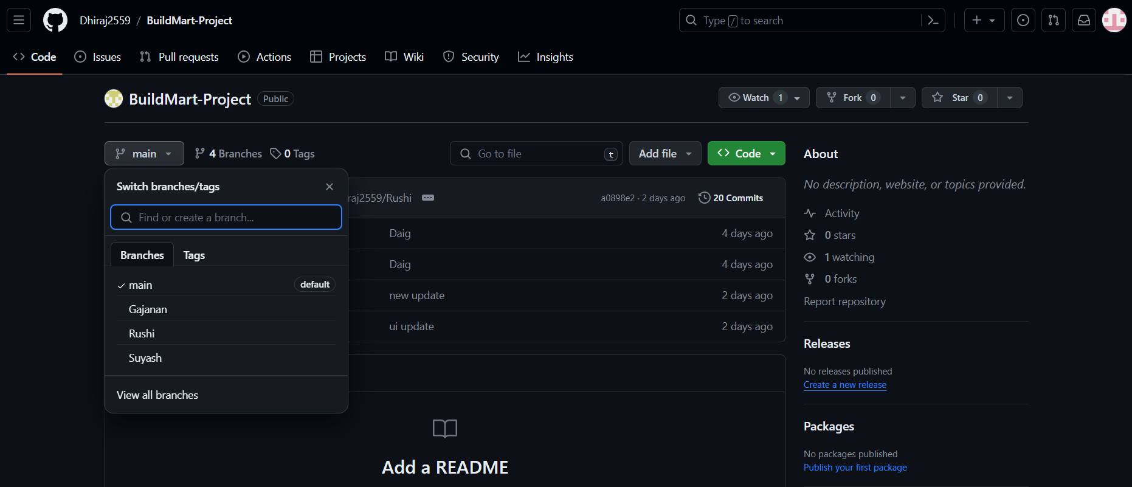
8.GitHub Repository :
GitHub link : https://github.com/Dhiraj2559/BuildMart-Project

Slide 13
9.Division of work within team :
Dhiraj Nagargoje : Implemented the Vendor and User use cases.
Gajanan Shinde : Implemented the Admin and Vendor use cases.
Rushikesh Nikam: Implemented User and Vendor use cases.
Suyash Bhonde: Implemented Admin and User use cases.
Stages at which Coordination was needed :
Most of the coordination was needed when complete UI needed to be rendered using React
Every one worked together for designing the database

Slide 14
10.Future Scope :
In the future, there is potential to expand our project to include Construction Companies and Service Providers, enabling a broader spectrum of industry stakeholders to participate.
Enhancing online presence and e-commerce capabilities
BuildMart has the opportunity to expand its range of products, so people can find even more things they need for construction and improving their homes.

Slide 15
11.Conclusion :
Challenges Faced :
We encountered numerous challenges, including determining the right path to commence our project and exploring technologies beyond the scope of our initial training.
Lessons Learned :
Throughout the process, we acquired valuable insights into effectively distributing tasks within the team and integrating diverse technologies to develop a comprehensive software solution.
Overall Experience :
Our journey was marked by practical learning experiences and a wealth of knowledge, contributing significantly to our growth and development.

Slide 16
THANK YOU !

